Slide 1
Presented by
Mingfeng Li
Yinan Ling
Nan You
Jinhao Zhang
Tech-Transfer Analysis

Slide 2
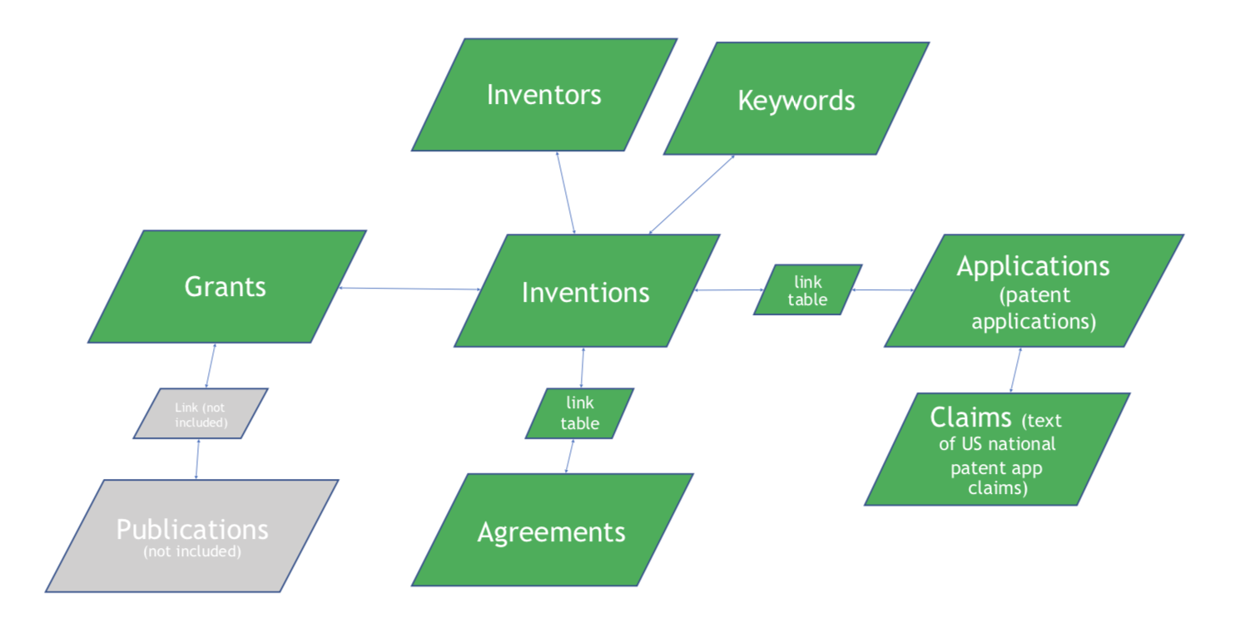
Columbia
Technology Ventures
Entity-Relationship
Diagram:
Notes:
transform research inventions to real-world commercial impacts including agreements with companies and patent applications.
CTV’s core mission is to facilitate the transfer of inventions from academic research labs to the market for the benefit of society on a local, national, and global basis.

Slide 3

Objective
Use the selected features and the model to classify and predict the inventions into 6 categories by their abilities to make money

Slide 4

How to categorize the inventions
Divided by the amount of revenue of their agreements with companies:
“A” - $0
“B” - 0-$10K
“C” - $10K-$100K
“D” - $100K-$1M
“E” - >$1M
“Z” - did not obtain any agreement
Notes:
revenue - what we are predicting

Slide 5


Initial Analysis
The relevant features :
Invention Key (serve as index)
PeopleKey- The number of People Collaborating
Department- The number of Departments Collaborating
Notes:
从peoplekey开始讲
impact of colaboration

Slide 6
Initial Analysis
The relevant features :
fundingAmount - Total Funding amount received
Type - Agreements Type
countryCode - count of countries inventions applied for patents
Application Status

Slide 7
Initial Analysis
The relevant features :
Application Status
abandoned ->0 expired ->0.5 filed ->0.5 issued ->1

Slide 8

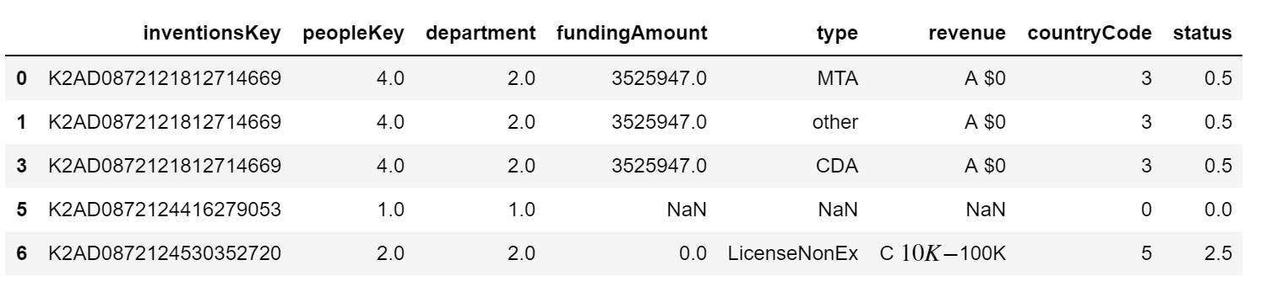
Initial Analysis
- Data Cleaning
1. Join all the relevant features to one table

Slide 9
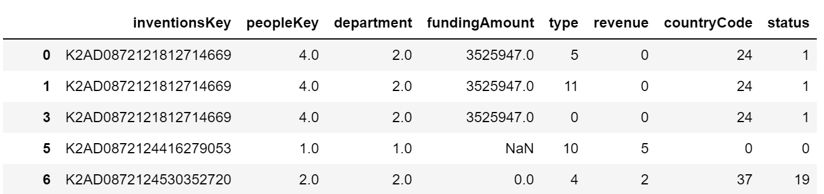
Initial Analysis
- Data Cleaning
2. Change the data types to numeric ones that can be easily analyzed

Slide 10
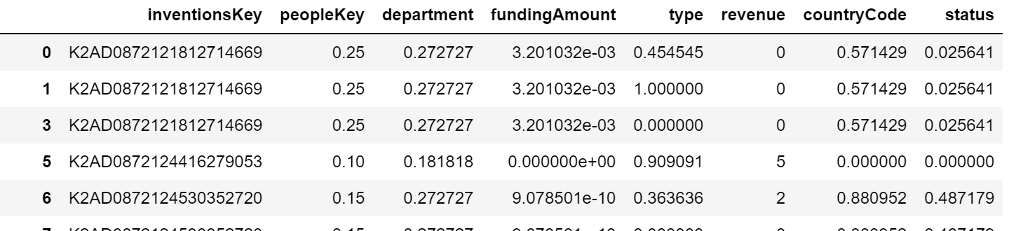
Initial Analysis
- Data Cleaning
3. Normalize the data and take care of all the invalid data (missing values) in the data set
n=11,465

Slide 11
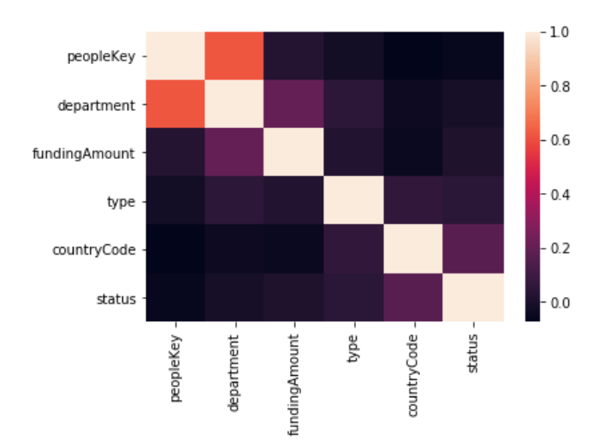
Initial Analysis
- Correlation Analysis
Fairly strong correlation exists between the number of departments and the number of people collaborating, as expected

Slide 12
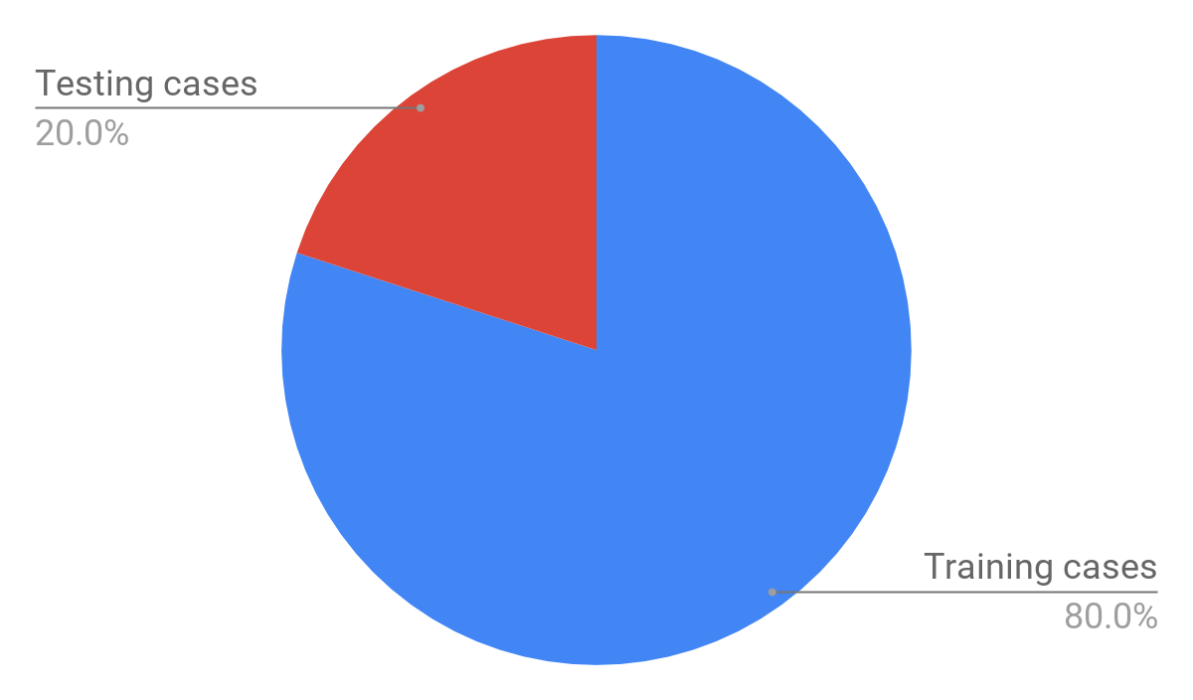
Machine Learning
- Splitting the data
80% of data is randomly chosen to be the training cases
The remaining 20% is chosen to be the testing cases

Slide 13

Machine Learning
- Choice of Algorithm
Neural Network

Slide 14
Result
- Model Accuracy
92% Accuracy!!! in the first place
But……………
We realized that the set is biased because there are two many zeros in the “revenue” feature
Too many 0’s means too many data fall into Category ‘A’

Slide 15
Result
- Model Improvement
Apply balancing
Balanced the batch data by randomly selecting the same amount of data from each revenue category

Slide 16

Result
- Model Accuracy after Balancing the Data
78.7% accuracy
in test cases

Slide 17
Conclusion
Use the selected features and the model to predict and classify the inventions into 6 categories by their abilities to make money
We trained a Neural Network model that has 78.7% of accuracy in classification
Notes:
future applications: input the features of new inventions into model to predict their commercial revenue, which can be helpful for companies to select the inventions they want to invest.

Slide 18

Future Work
A further in-depth analysis of each factor’s commercial impact
Take the time into consideration

